Slide 1
EGR101Sim
Sprint 2 Demo
Emily Connearney, Luke Crump, Vivian Dang, ​
Daniel Khalil, Keely Mashburn

Slide 2
Project Description
An application that allows virtual bot design with:
component configuration
wiring layout
3D simulation
Packaged with an Arduino IDE.

Slide 3
Project Use
Students couldn’t do hands-on due to COVID-19.
Cheaper alternative to buying an $85 kit.
Fully emulates EGR101.

Slide 4
Assumptions/Dependencies
Constraints
Students are familiar with the kit and its components ​
Students also understand assigned task and what to do ​
Only the professor can add additional components and pieces to the kit ​
The application must be able to run on different operating systems ​
Project is constrained by the kit provided to the EGR 101 students ​
Cannot have functionality or components that the actual robot and kit does not have

Slide 5
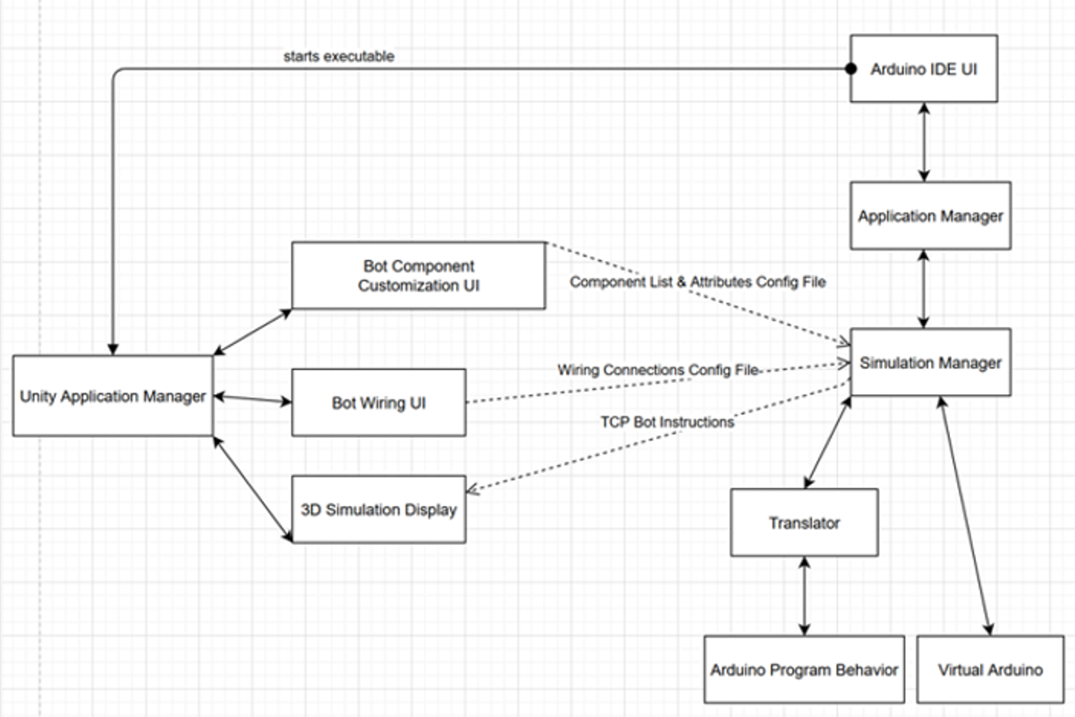
Architectural Diagram

Slide 6
Major Sub-Systems
Design/Wiring Interface
Arduino IDE
Arduino Emulation

Slide 7
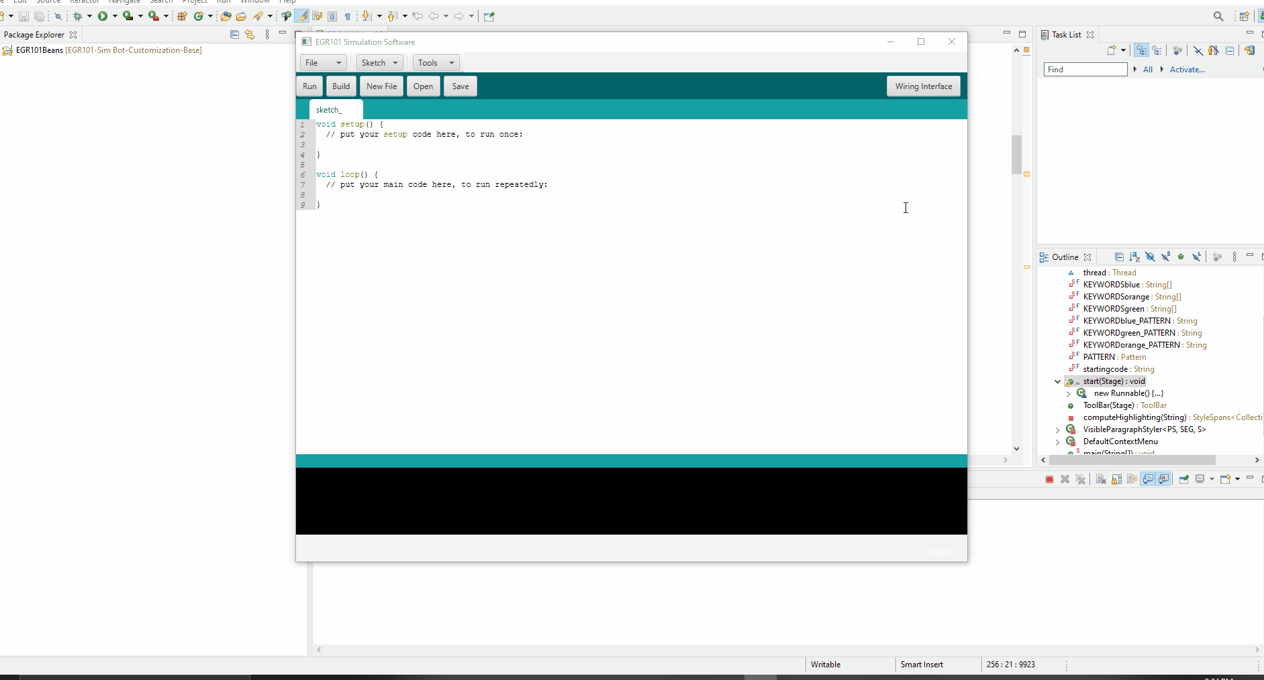
Design/Wiring Interface

Slide 8
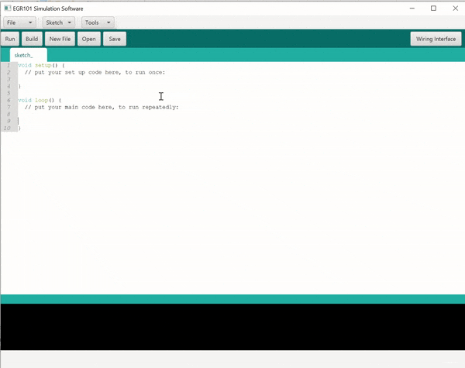
Arduino IDE
Updated IDE to better mimic the Arduino IDE.
Added keyword coloring and line numbers.
New button to connect IDE to wiring interface.

Slide 9
Arduino Emulation
Created Arduino Translated APIs for:
Servo
Serial
Added 4 New Components
Distance Measuring IR Sensor
Line reading IR Sensor
Ultrasonic Sensor
Continuous Servo Motor

Slide 10
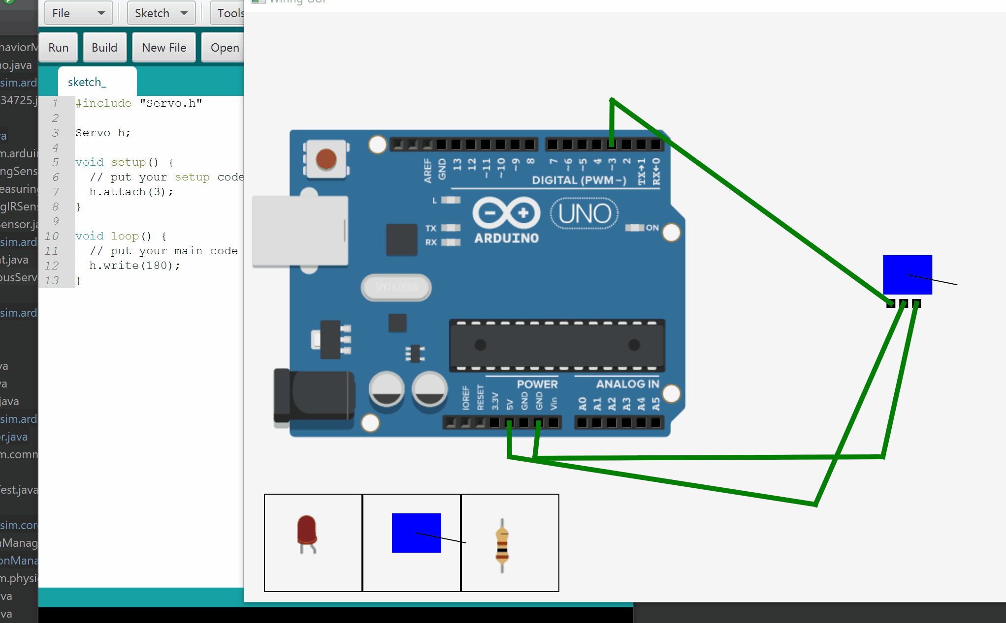
Arduino Emulation: Servo Motors

Slide 11

Servo Motors

Slide 12
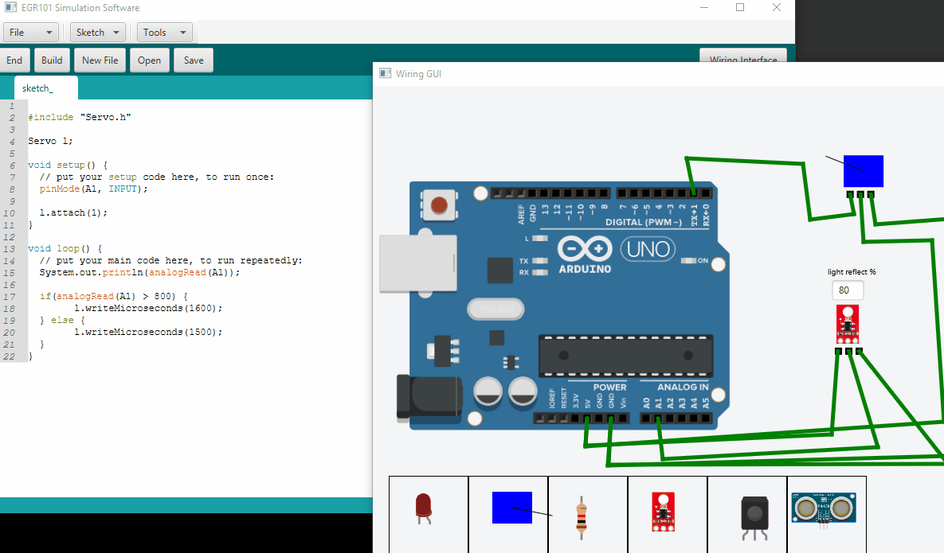
Line Reading IR Sensor

Slide 13
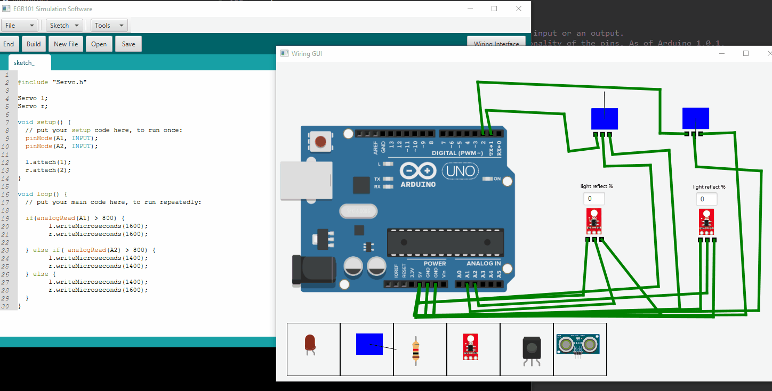
EGR 101 Line Following

Slide 14
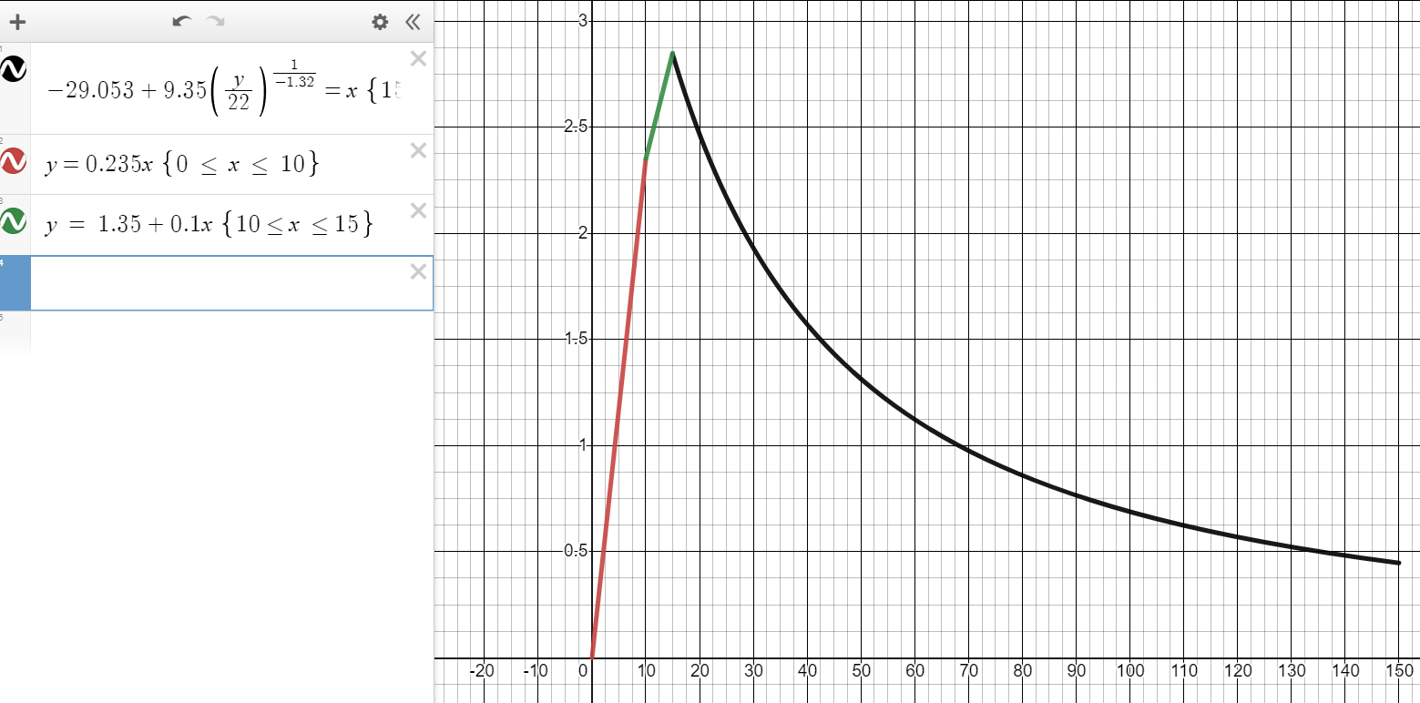
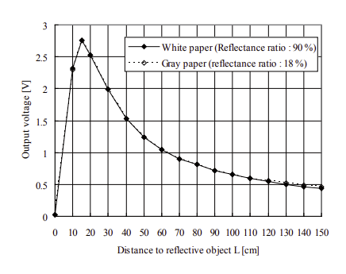
Simulating Distance-Measuring IR Sensor
SHARP GP2Y0A02YK0F

Slide 15
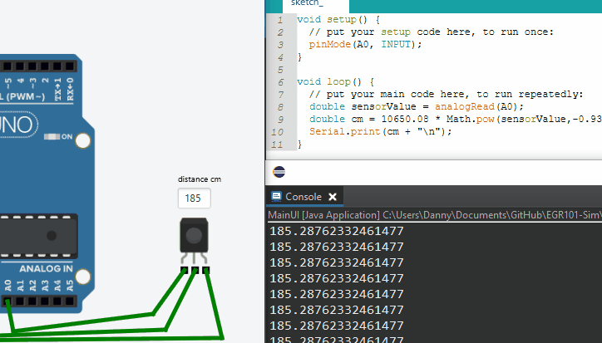
Distance-Measuring IR Sensor Demo

Slide 16
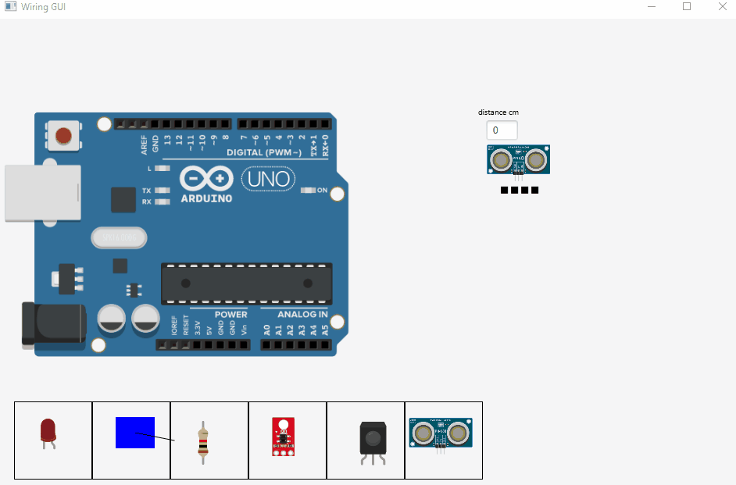
Ultrasonic Sensor

Slide 17
Sprint Timeline
SPRINT 1
SPRINT 2
SPRINT 3
Initial GUI for bot customization​
Initial GUI for Arduino IDE​
Arduino emulation can handle simple circuits​
Able to translate Arduino code into Java code
Arduino IDE should be fully styled​
Arduino emulation includes all needed components​ except color sensor
Fully functional 3D Boe-Bot simulation​
Fully functional bot customization
Functional wiring GUI

Slide 18
Lessons Learned
Be more professional/lively during presentations.
Have more cohesive slides.
Better time management.

Slide 19
Questions?
Thank you for watching our presentation!

